Slide 1
Discrete Mathematics
What is graph?
Graph– Lesson 8
March 27th, 2016

Slide 2
Graph
Graphs are discrete structures consisting of vertices and edges that connect these vertices.
A graph G = (V ,E) consists of V , a nonempty set of vertices (or nodes) and E, a set of edges.

Slide 3
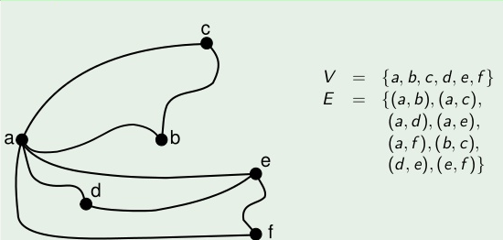
Graph

Slide 4
Why Graph?
Using graph models, we can determine whether it is possible to walk down all the streets in a city without going down a street twice
we can find the number of colors needed to color the regions of a map.

Slide 5
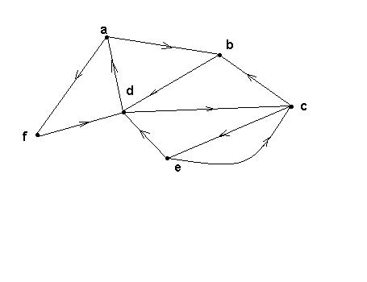
Directed Graphs
G is a directed graph or digraph if each edge has been associated with an ordered pair of vertices, i.e. each edge has a direction

Slide 6
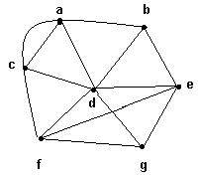
Degree of a vertex
The degree of a vertex v, denoted by deg(v), is the number of edges incident on v
Example:
deg(a) = 4, deg(b) = 3,
deg(c) = 4, deg(d) = 6,
deg(e) = 4, deg(f) = 4,
deg(g) = 3.

Slide 7
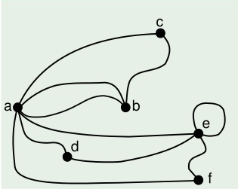
Determine the degree of all nodes
What is the degree of e?
A vertex with a loop "sees" itself as an adjacent vertex from both ends of the edge thus adding two, not one, to the degree.

Slide 8
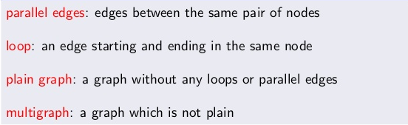
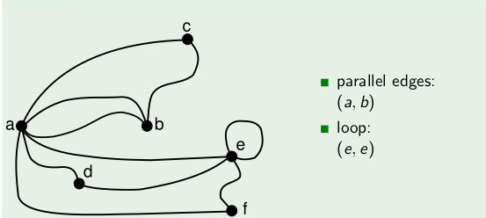
Some definitions

Slide 9
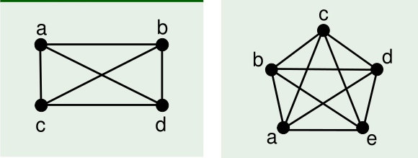
Complete Graph

Slide 10
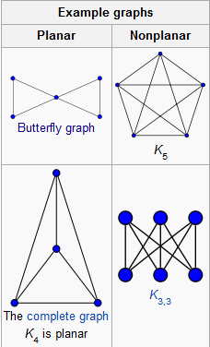
Planer Graph
In graph theory, a planar graph is a graph that can be embedded in the plane, i.e., it can be drawn in such a way that no edges cross each other.

Slide 11
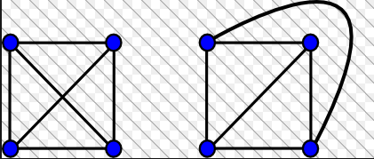
More planer graphs

Slide 12
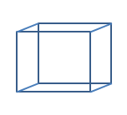
Try yourself: Is this a planar graph?

Slide 13
Bipartite Graphs
Sometimes a graph has the property that its vertex set can be divided into two disjoint subsets such that each edge connects a vertex in one of these subsets to a vertex in the other subset.

Slide 14
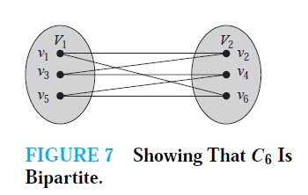
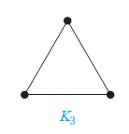
Examples
C6 is bipartite, as shown in Figure 7, because its vertex set can be partitioned into the two sets V1 = {v1, v3, v5} and V2 = {v2, v4, v6}, and every edge of C6 connects a vertex in V1 and a vertex in V2.
K3 is not bipartite. To verify this, note that if we divide the vertex set of K3 into two disjoint sets, one of the two sets must contain two vertices. If the graph were bipartite, these two vertices could not be connected by an edge, but in K3 each vertex is connected to every other vertex by an edge.

Slide 15
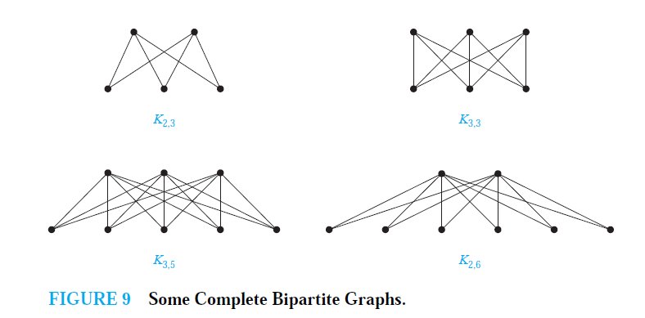
Complete bipartite graph

Slide 16
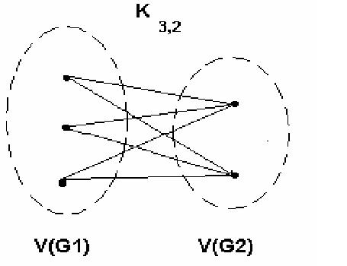
complete bipartite graph
A bipartite graph is the complete bipartite graph K_{m,n} if every vertex in V(G₁) is joined to a vertex in V(G₂) and conversely

Slide 17
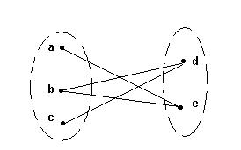
bipartite graph
No edges exist between any two vertices in the same subset .

Slide 18
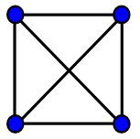
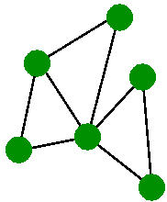
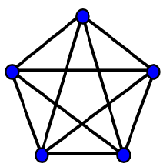
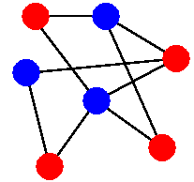
Check whether bipartite or not!

Slide 19
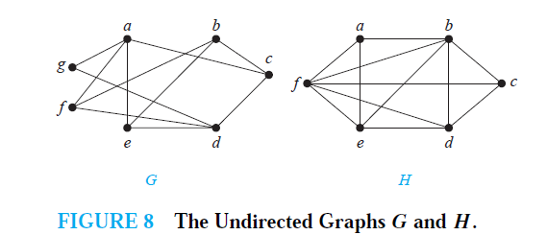
Check whether bipartite or not!

Slide 20
Bipartite Graphs
EG: C₄ is a bichromatic:
And so is bipartite, if we redraw it:
L23
20

Slide 21
Bipartite Graphs
EG: C₄ is a bichromatic:
And so is bipartite, if we redraw it:
L23
21

Slide 22
Bipartite Graphs
EG: C₄ is a bichromatic:
And so is bipartite, if we redraw it:
L23
22

Slide 23
Bipartite Graphs
EG: C₄ is a bichromatic:
And so is bipartite, if we redraw it:
L23
23

Slide 24
Bipartite Graphs
EG: C₄ is a bichromatic:
And so is bipartite, if we redraw it:
L23
24

Slide 25
Bipartite Graphs
EG: C₄ is a bichromatic:
And so is bipartite, if we redraw it:
L23
25

Slide 26
Bipartite Graphs
EG: C₄ is a bichromatic:
And so is bipartite, if we redraw it:
L23
26

Slide 27
Bipartite Graphs
EG: C₄ is a bichromatic:
And so is bipartite, if we redraw it:
L23
27

Slide 28
Bipartite Graphs
EG: C₄ is a bichromatic:
And so is bipartite, if we redraw it:
L23
28

Slide 29
Bipartite Graphs
EG: C₄ is a bichromatic:
And so is bipartite, if we redraw it:
L23
29

Slide 30
Bipartite Graphs
EG: C₄ is a bichromatic:
And so is bipartite, if we redraw it:
Q: For which n is C_{n} bipartite?
L23
30

